Slide 2

MODERN FACILITIES AND EQUIPMENTS
OF LTTC

Slide 3
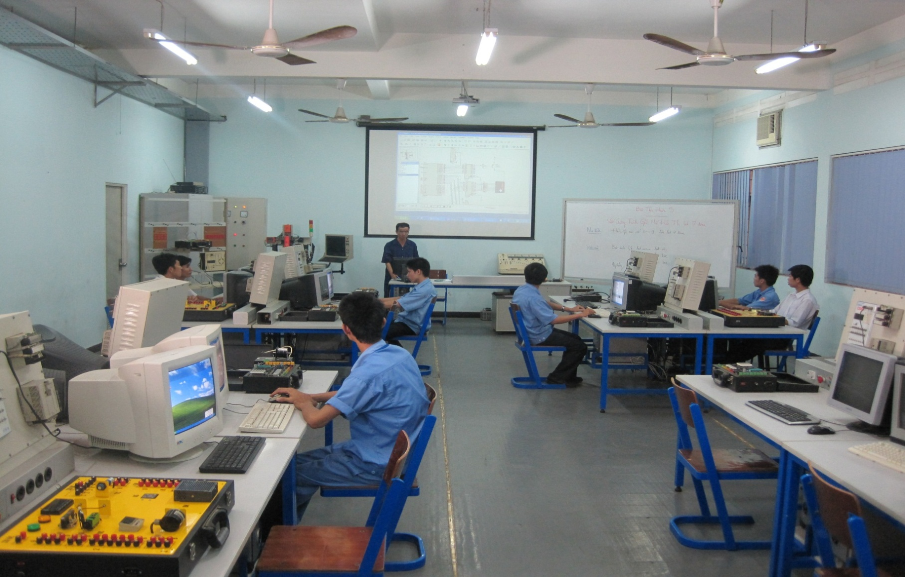
MULTIMEDIA ROOM

Slide 4
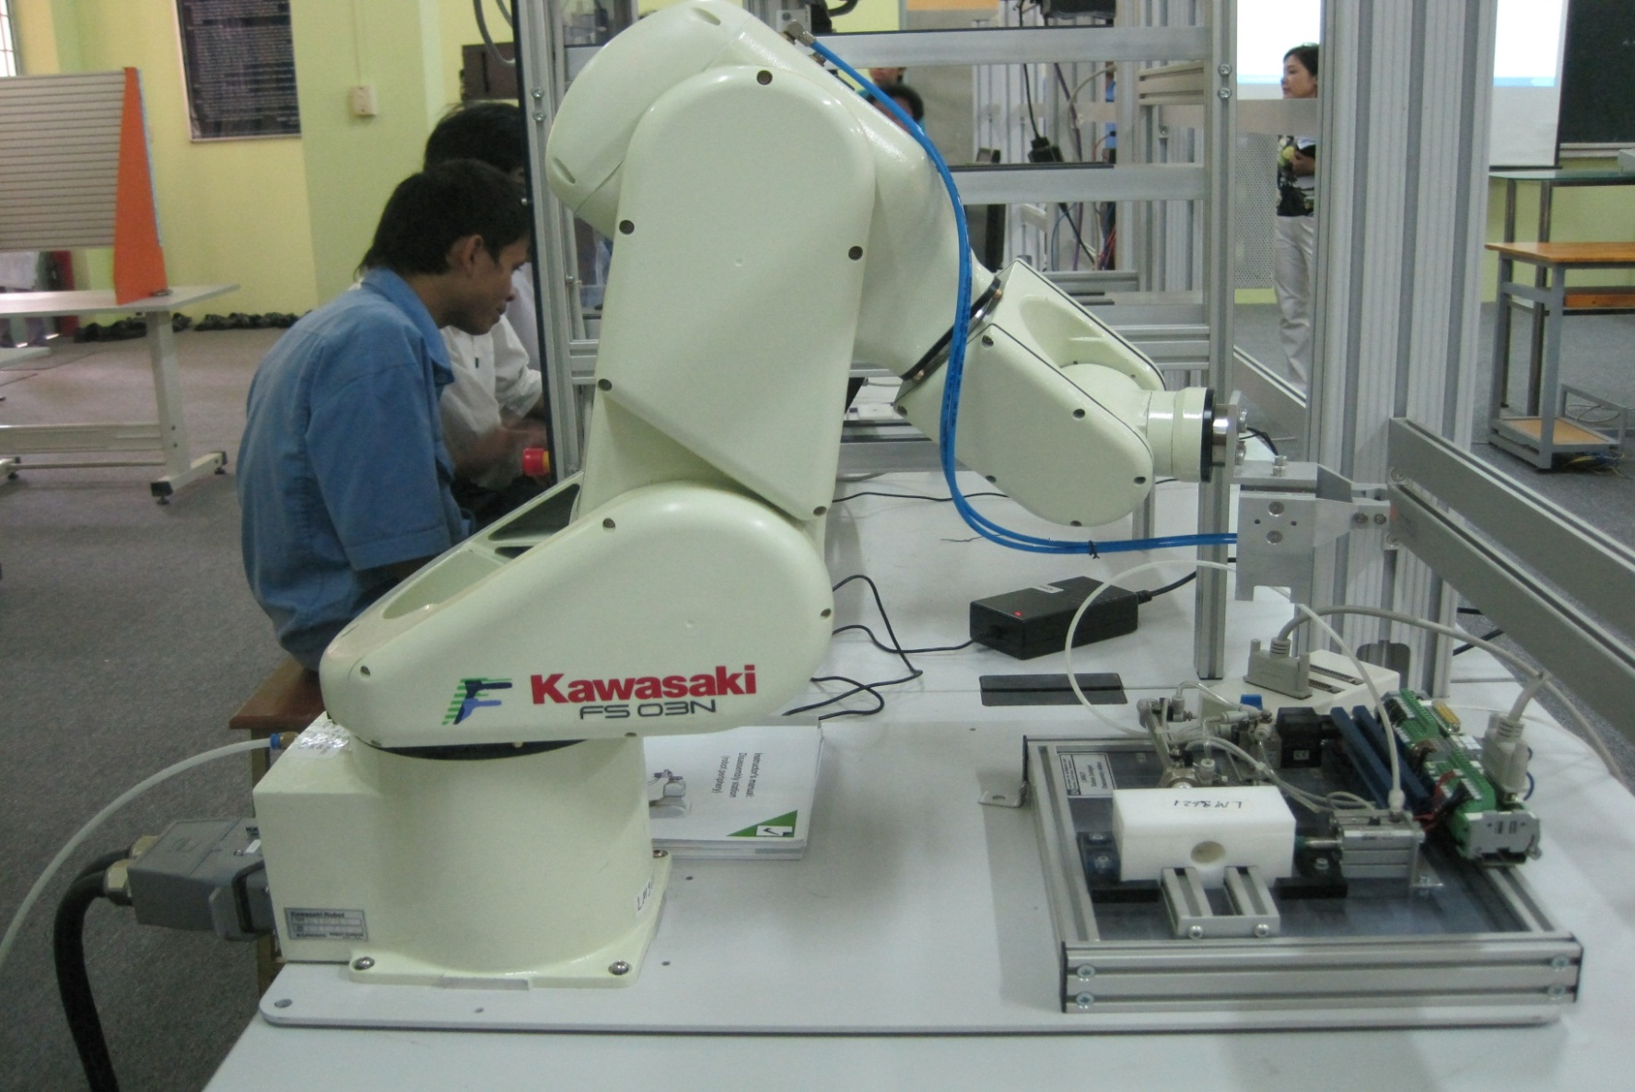
ROBOT PRACTICE ROOM

Slide 5
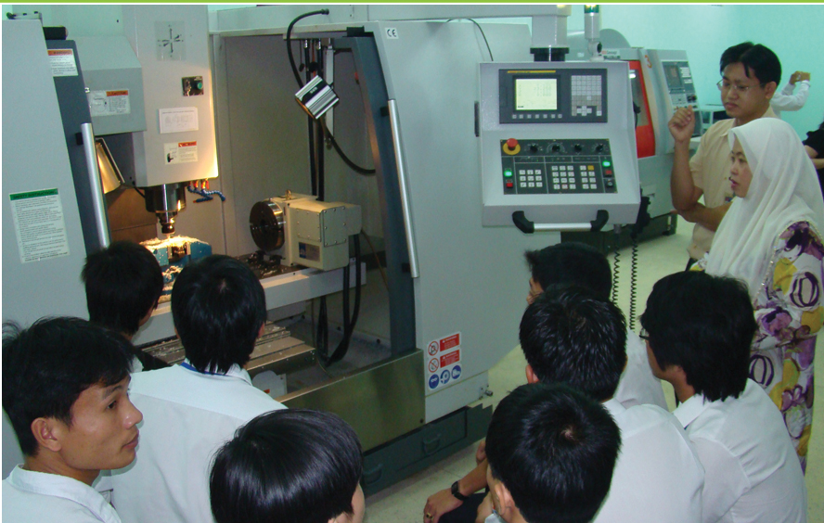
CNC BARON MAX VM20

Slide 6
OUTSTANDING ACTIVITIES
OF LTTC

Slide 7
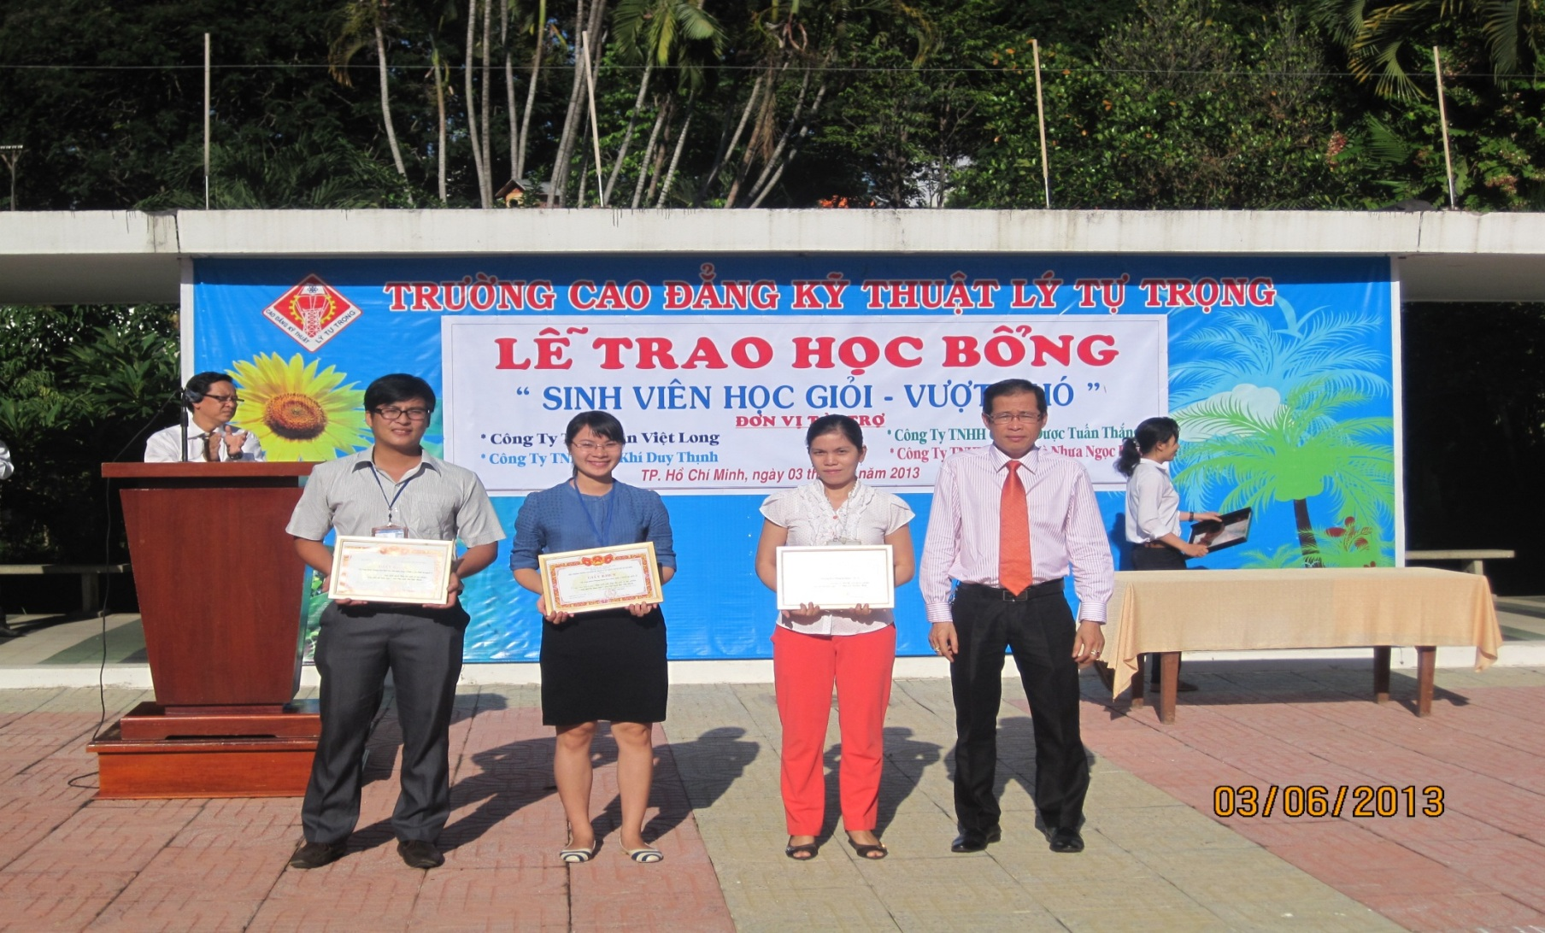
TRAO GIẢI CUỘC THI VIẾT VỀ TÁC PHẨM
“SỬA ĐỔI LỐI LÀM VIỆC”

Slide 8
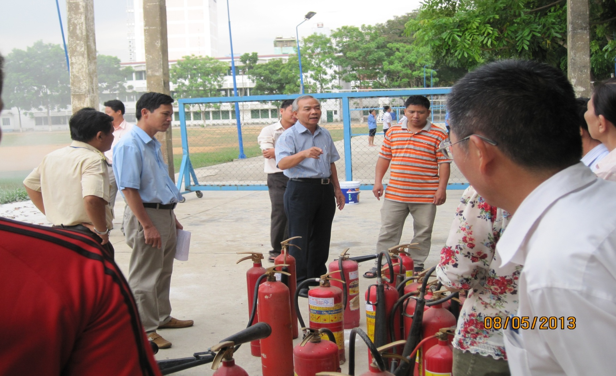
FIRE PROTECTION TRAINING

Slide 9
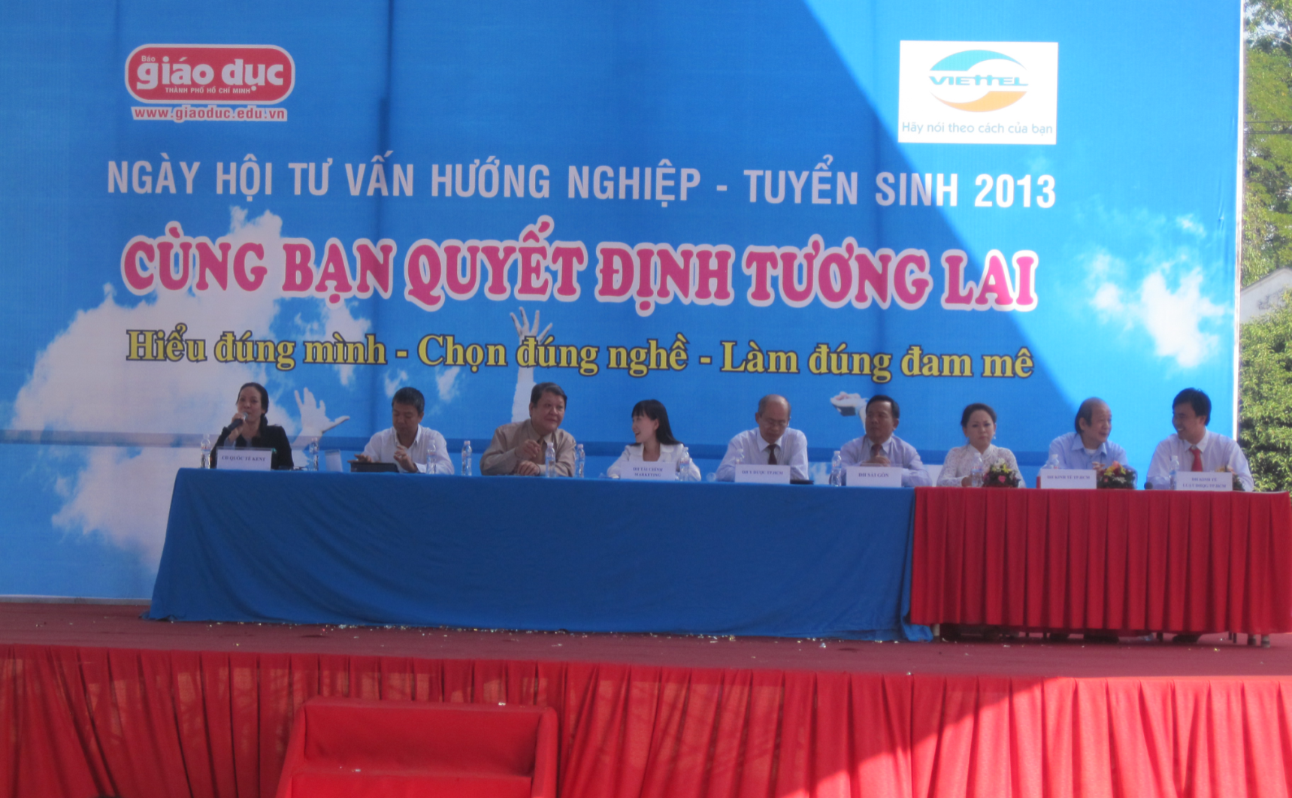
CAREER CONSULTANCY AND ADMISSION DAY 2013

Slide 10
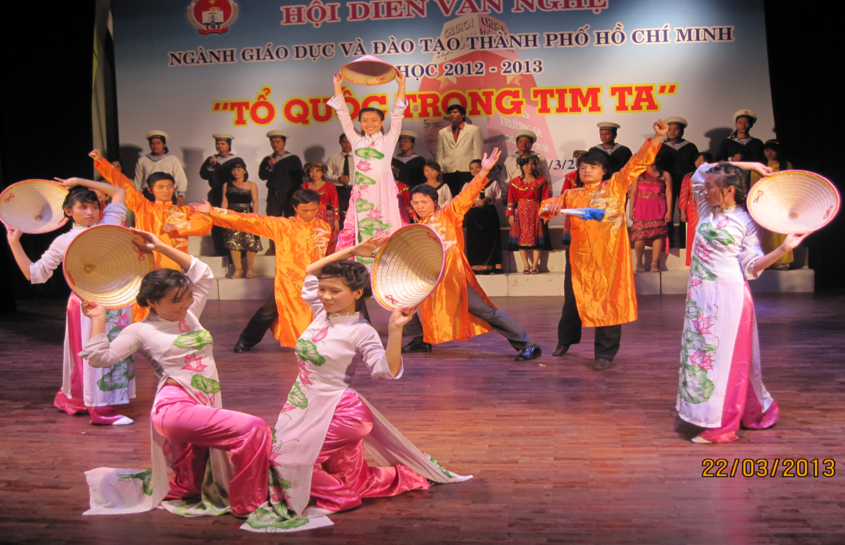
ANNUAL MUSICAL VARIETY FESTIVAL OF
EDUCATION & TRAINING FIELD HCMC
2012 – 2013

Slide 11
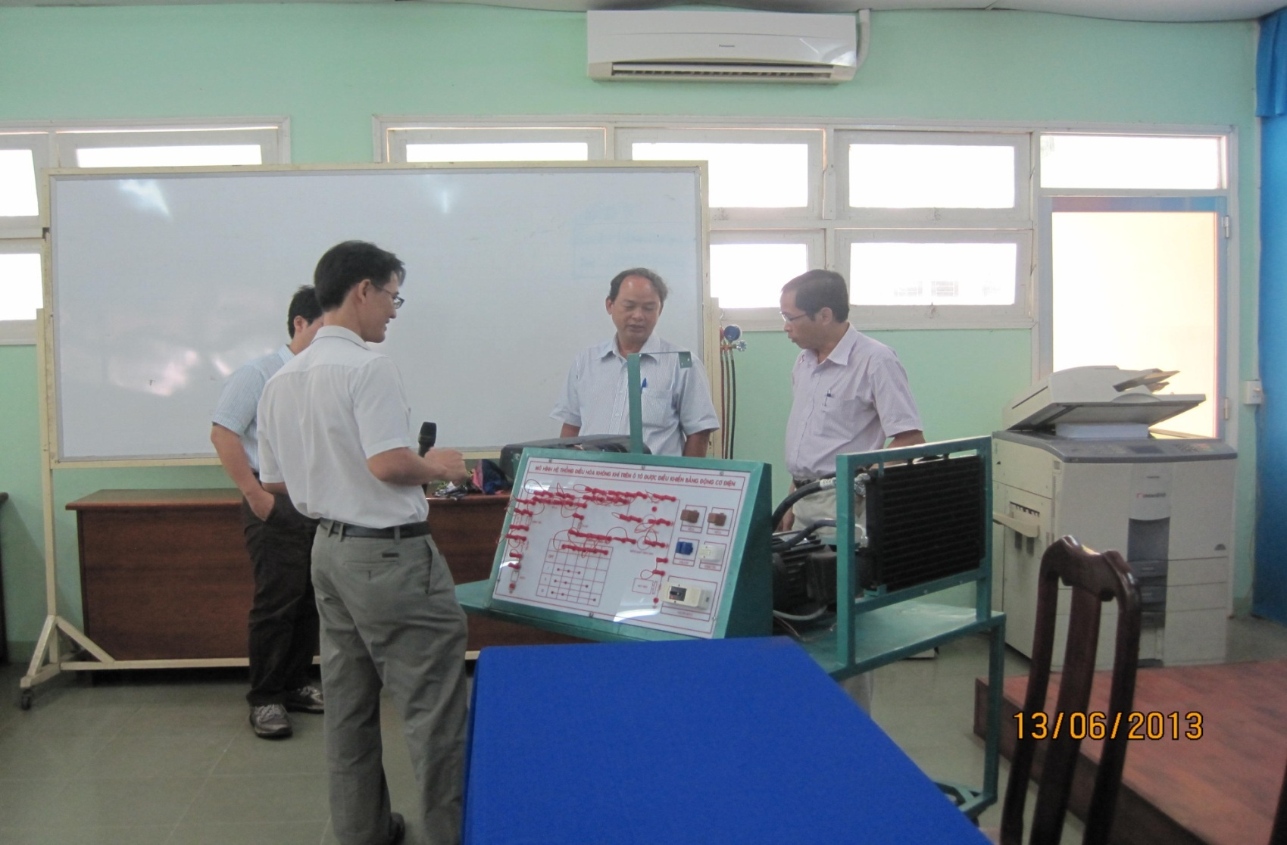
LTTC’S SCIENTIFIC RESEARCH INSPECTATION 2013

Slide 12
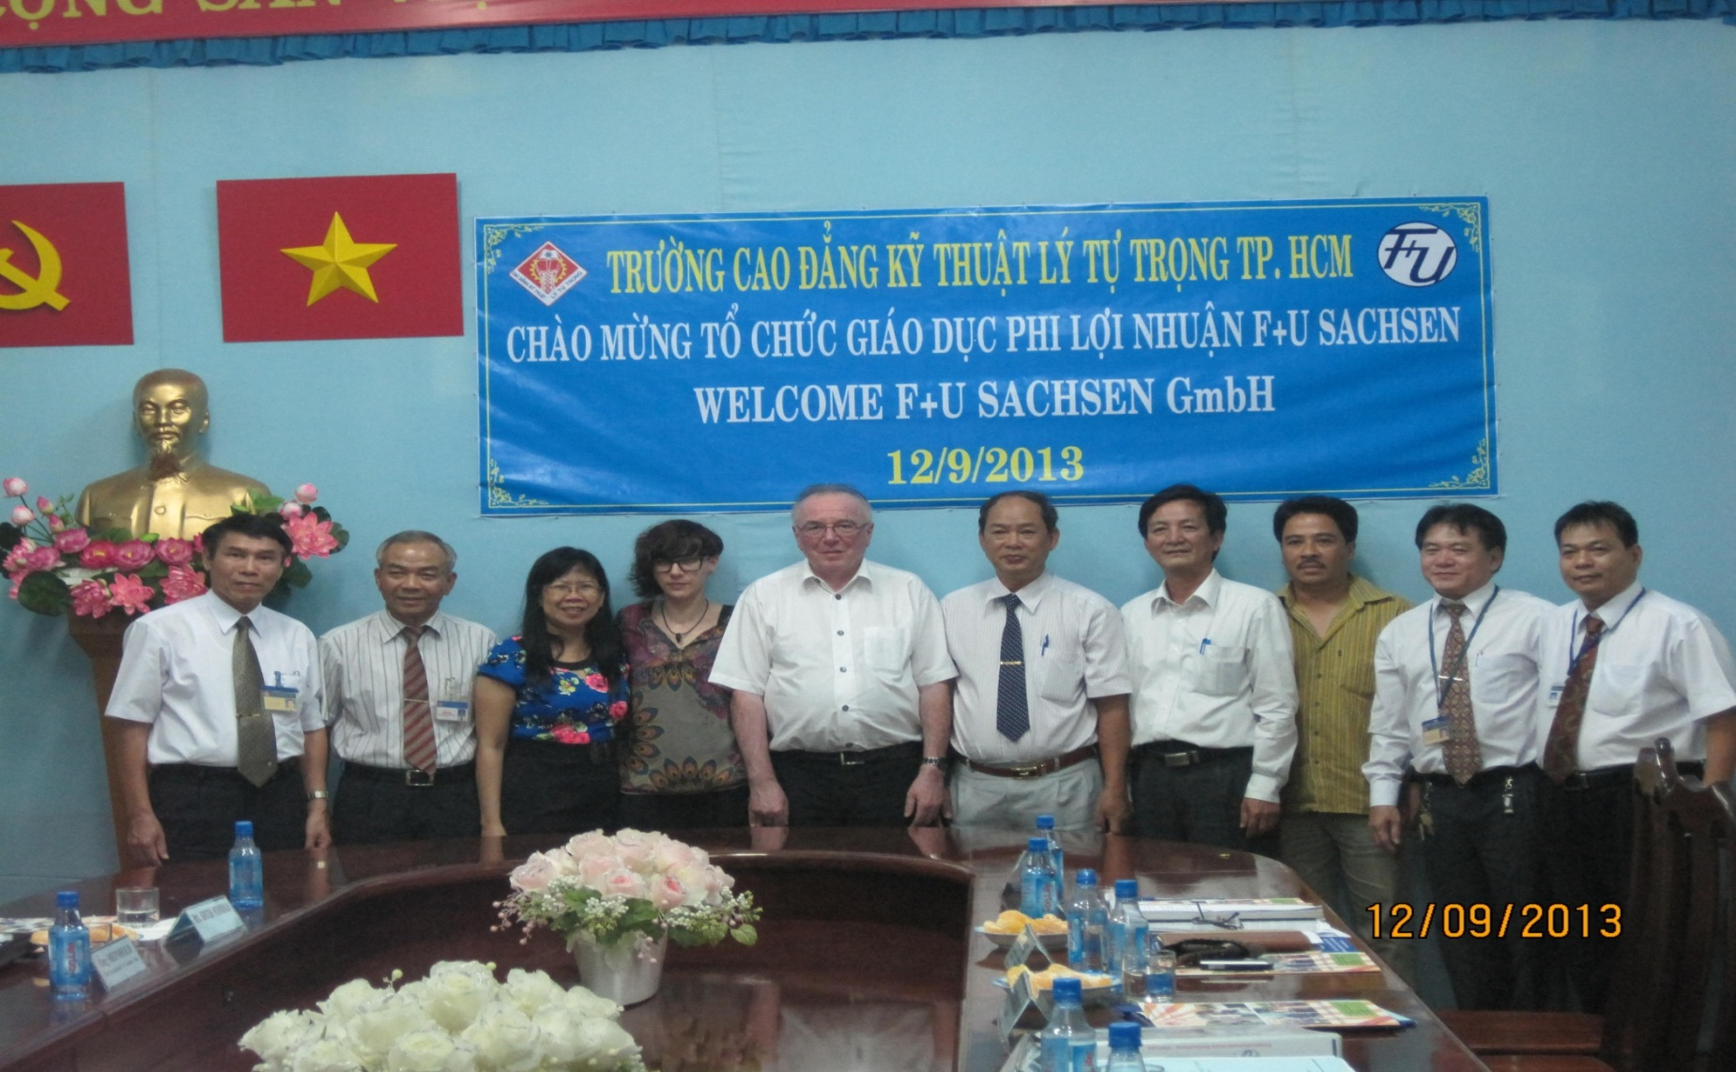
NONPROFIT EDUCATIONAL ORGANIZATION F+U SACHSEN - GERMANY

Slide 13

LY TU TRONG TECHNICAL COLLEGE
HO CHI MINH CITY
390 HOANG VAN THU, WARD 4, TAN BINH DISRICT, HCMC
TEL: (848)-8440567; (848)-4490589
www.lttc.edu.vn

